Slide 1

Coding Fundamentals & Basics of Programming

Slide 2
Agenda
In this session, you will learn about:
Basics of Programming
Programming Environment
Fundamental Keywords
Basic Operators
Decision Making operators
Loop Statements
Functions in the program
File I/O

Slide 3

Basics of Programming

Slide 4
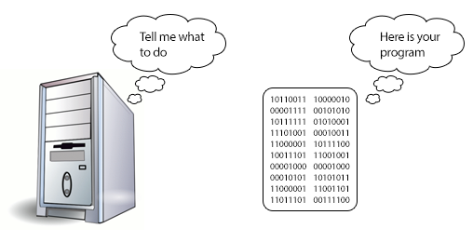
Computer Program
Sequence of instructions written using a Computer Programming Language
To perform a specified task by the computer.
Two Important Terms
Sequence of Instructions.
Computer Programming Language

Slide 5
Computer Programming Languages
Similar to Human Interface Languages, Computer Programming Languages are also made of several elements which are listed below:
Programming Environment
Basic Syntax
Data Types
Variables
Keywords
Basic Operators
Decision Making
Loops
Numbers
Characters
Arrays
Strings
Functions

Slide 6
Programming Environment

Slide 7

Computer Programming Environment
Computer programming environment simply implies a base on top of which we can do our programming.
It is the first step to be followed before setting on to write a program.
We need to have the required software setup, i.e., installation on our PC which will be used to write computer programs, compile, and execute them.
For example, if you need to browse Internet, then you need the following setup on your machine:
A working Internet connection to connect to the Internet
A Web browser such as Internet Explorer, Chrome, Safari, etc.

Slide 8
Setup
Any programming language will need the following setup to start with programming.
A text editor or IDE to create computer programs
A compiler to compile the programs into binary format
An interpreter to execute the programs directly

Slide 9
Setup: Text Editor
A text editor or IDE to create computer programs
Any word processing program that you can use to type and edit text.
Word Pad and Notepad for Windows
SimpleText and Text Edit for the Mac

Slide 10
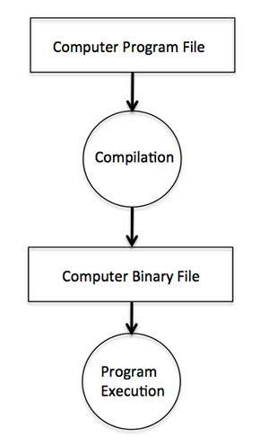

Setup: Compiler
The computer cannot understand your program directly given in the text format, so we need to convert this program in a binary format, which can be understood by the computer.
The conversion from text program to binary file is done by another software called Compiler.
This process is called program compilation.

Slide 11
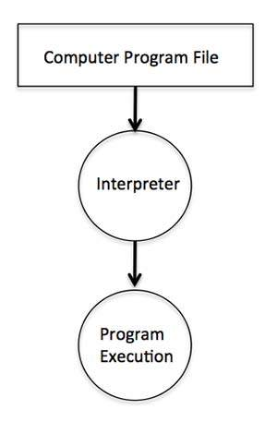
Setup: Interpreter
Programming languages do not need any compilation into binary format.
Programming languages such as Python, PHP, and Perl, which do not need any compilation into binary format
An interpreter can be used to read such programs line by line and execute them directly without any further conversion.
Execute them directly without any further conversion.

Slide 12
Interpreter
Program Execution
Computer Program File

Slide 13
Fundamental Keywords

Slide 14
Data Types
Data Types
Following are the common data types in java
We will see more examples in next session
Type | Keyword | Example
Character | char | char letter =‘a’ ; Will use single quote
Number | int | int count =35; Any numeric non decimal
Decimal Number | double | double percent =77.8; numeric decimal values
String | String | String name=“Mr X”

Slide 15
Variables
Variables
The names you give to computer memory locations which are used to store values in a computer program.
For example, assume you want to store two values 10 and 20 in your program and at later stage, you want to use these two values.
Here are the following three simple steps:
Create variables with appropriate names.
Store your values in those two variables.
Retrieve and use the stored values from the variables.

Slide 16
Keywords
Keywords
Keyword is a word that is reserved by a program because the word has a special meaning.
Keywords can be commands or parameters.
Every programming language has a set of keywords that cannot be used as variable names.
Keywords are sometimes called reserved names
Sample Keywords in Java are listed below, We will learn more about keywords in next session
abstract | assert | boolean | break
byte | case | catch | char
class | const | continue | default
do | double | else | enum

Slide 17
Basic Operators

Slide 18
Arithmetic Operators
Arithmetic Operators
Arithmetic Operators in language help us to perform mathematical calculation between variables
Operator | Description
+ | Add two operands
- | Subtract second operand from the first
* | Multiplies both operands
/ | Divides numerator b de-numerator
% | This gives reminder of an integer division

Slide 19
Relational Operators
Relational Operators
Relational Operators in language help us to perform comparison between variables & expressions
Operator | Description | Example
== | Checks if the values of two operands are equal or not, if yes then condition becomes true. | (A == B) is not true.
!= | Checks if the values of two operands are equal or not, if values are not equal then condition becomes true. | (A != B) is true.
> | Checks if the value of left operand is greater than the value of right operand, if yes then condition becomes true. | (A > B) is not true.
< | Checks if the value of left operand is less than the value of right operand, if yes then condition becomes true. | (A < B) is true.

Slide 20
Decision Making Operators

Slide 21
Logical Operators
Logical operators help us take decisions based on certain conditions in any programming language.
Operator | Description | Example
&& | Called Logical AND operator. If both the operands are non-zero, then condition becomes true. | (A && B) is false.
|| | Called Logical OR Operator. If any of the two operands is non-zero, then condition becomes true. | (A || B) is true.
! | Called Logical NOT Operator. Use to reverses the logical state of its operand. If a condition is true then Logical NOT operator will make false. | !(A && B) is true.

Slide 22
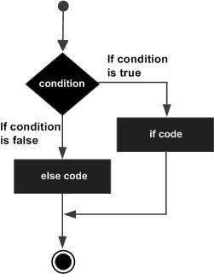
Computer Programming- Decision making
If – else statement
Decision making is critical to computer programming.
An if statement can be followed by an optional else statement, which executes when the Boolean expression is false.

Slide 23
If – else statement
The syntax of an if...else statement in most programming languages might be:
if(boolean_expression) {
/* Statement(s) will execute if the boolean expression is true */
} else {
/* Statement(s) will execute if the boolean expression is false */
}

Slide 24
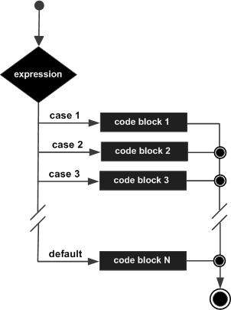
Computer Programming- Decision Making
Switch Statement
A switch statement is an alternative of if statements which allows a variable to be tested for equality against a list of values
Each value is called a case, and the variable being switched on is checked for each switch case.
We will learn more about switch statement in upcoming sessions.

Slide 25
Loop Statements

Slide 26
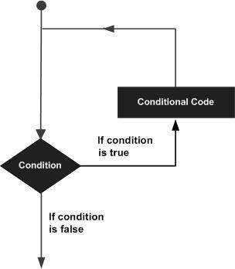
Computer Programming-Loop statement
Loop statement
A loop statement allows us to execute a statement or group of statements multiple times
There are 3 types of loop control statements in C language. They are,
for
while
do-while

Slide 27
Functions in the Programming

Slide 28
Computer Programming
Functions
A function is a block of organized, reusable code that is used to perform a single, related action.
Functions provide better modularity for your application and a high degree of code reusing.
A function definition consists of a function header and a function body. Following are all the parts of a function
Function Name − This is the actual name of the function. The function name and the parameter list together constitute the function signature.

Slide 29
Computer Programming
Functions
A function definition consists of a function header and a function body. Following are all the parts of a function:
Parameter List − A parameter is like a placeholder. When a function is invoked, you pass a value as a parameter. This value is referred to as the actual parameter or argument. The parameter list refers to the type, order, and number of the parameters of a function. Parameters are optional; that is, a function may contain no parameters.
Function Body − The function body contains a collection of statements that defines what the function does.
Return Type − A function may return a value. The return_type is the data type of the value the function returns. Some functions perform the desired operations without returning a value. In this case, the return_type is the keyword void.

Slide 30
File I/O

Slide 31
Computer Programming
File I/O
File input means data that is written into a file and file output means data that is read from a file.
A simple program opens a text file, writes a few text lines into it, and closes the file.
The same file is opened and then read from an already created file.

Slide 32

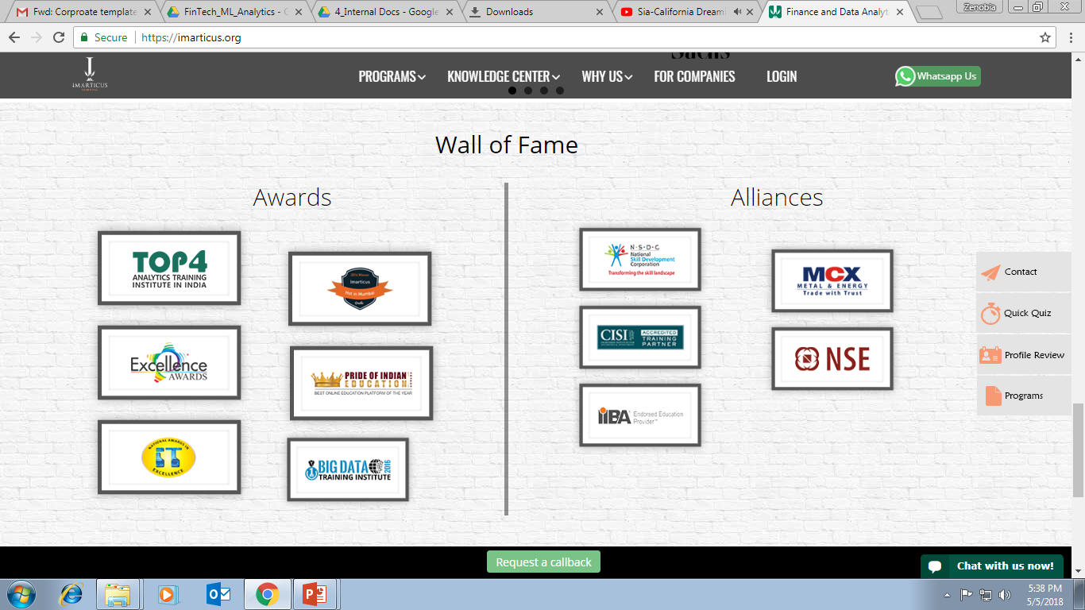



AWARDS:
Learn more:
https://imarticus.org/corporate/
Email us:
info@imarticus.com
Connect with us:
www.linkedin.com/company/imarticuslearning
ACCREDITED TRAINING PARTNER:
Watch us:
www.youtube.com/ImarticusLearninginstitute
Visit us:
Mumbai | Thane | Pune | Bangalore | Delhi - NCR | Hyderabad | Chennai | Coimbatore

